Slide 1
Here’s our equivalent circuit for a cell membrane with an (open) channel – part of the LIF model
I_{input}
C₀
R₀
To gain biophysical intuition, let’s examine how this circuit behaves as we inject charge ...

Slide 2
Case 1: Set C₀ = 1 farad, R₀ = 1 ohm
Time: t = 0 s
Not yet injecting current
No charge on capacitor
C₀
R₀

Slide 3
Case 1: Set C₀ = 1 farad, R₀ = 1 ohm, and I_{input} = 1 charge / sec = 1 amp
Time: t = 1 s
I_{input}
+
“Where do I go?”
“What is the voltage?”
i_{C} = I_{input} – i_{R} =
1 amp
i_{R} = V/R =
0 amp
Q = C V
V = 0 coloumb / 1 farad
V = 0
C₀
R₀
All charge goes to capacitor

Slide 4
Case 1: Set C₀ = 1 farad, R₀ = 1 ohm, and I_{input} = 1 charge / sec = 1 amp
Time: t = 2 s
I_{input}
+
“Where do I go?”
“What is the voltage?”
i_{C} = I_{input} – i_{R} =
0 amp
i_{R} = V/R =
1 amp
+
Q = C V
V = 1 coloumb / 1 farad
V = 1 volt
C₀
R₀
All charge leaves through resistor.
We’ve reached equilibrium
V* = 1 volt, τ = 1 s

Slide 5
Case 2: Set C₀ = 2 farad, R₀ = 1 ohm, and I_{input} = 1 charge / sec = 1 amp
Double the capacitance!
Time: t = 0 s
Not yet injecting current
No charge on capacitor
C₀
R₀

Slide 6
Case 2: Set C₀ = 2 farad, R₀ = 1 ohm, and I_{input} = 1 charge / sec = 1 amp
Time: t = 1 s
I_{input}
+
“Where do I go?”
“What is the voltage?”
i_{C} = I_{input} – i_{R} =
1 amp
i_{R} = V/R =
0 amp
Q = C V
V = 0 coloumb / 1 farad
V = 0
C₀
R₀
1st charge to capacitor

Slide 7
Case 2: Set C₀ = 2 farad, R₀ = 1 ohm, and I_{input} = 1 charge / sec = 1 amp
Time: t = 2 s
I_{input}
+
“Where do I go?”
“What is the voltage?”
i_{C} = I_{input} – i_{R} =
0.5 amp
i_{R} = V/R =
0.5 amp
+
Q = C V
V = 1 coloumb / 2 farad
V = 0.5 volt
C₀
R₀
½ to capacitor, ½ to resistor

Slide 8
Case 2: Set C₀ = 2 farad, R₀ = 1 ohm, and I_{input} = 1 charge / sec = 1 amp
Time: t = 3 s
I_{input}
+
“Where do I go?”
“What is the voltage?”
i_{C} = I_{input} – i_{R} =
0.25 amp
i_{R} = V/R =
0.75 amp
+
+
Q = C V
V = 1.5 coloumb / 2 farad
V = 0.75 volt
C₀
R₀
¼ to capacitor, ¾ to resistor

Slide 9
Case 2: Set C₀ = 2 farad, R₀ = 1 ohm, and I_{input} = 1 charge / sec = 1 amp
Time: t = 4 s
I_{input}
+
“Where do I go?”
“What is the voltage?”
i_{C} = I_{input} – i_{R} =
0.125 amp
i_{R} = V/R =
0.875 amp
+
+
+
Q = C V
V = 1.75 coloumb / 2 farad
V = 0.875 volt
C₀
R₀
7/8 to capacitor, 1/8 to resistor

Slide 10
Case 2: Set C₀ = 2 farad, R₀ = 1 ohm, and I_{input} = 1 charge / sec = 1 amp
Time: t = goes on
I_{input}
+
“Where do I go?”
“What is the voltage?”
i_{C} = I_{input} – i_{R} =
0 amp
i_{R} = V/R =
1 amp
+
+
Q = C V
V = 2 coloumb / 2 farad
V = 1 volt
C₀
R₀
Eventually (at equilibrium):
2 charges on capacitor
V* = 1 volt
τ = longer time ... (> 1 s)

Slide 11
Case 2: Set C₀ = 2 farad, R₀ = 1 ohm, and I_{input} = 1 charge / sec = 1 amp
So, double the capacitance:
double charge on capacitor
same target voltage (1 volt)
longer time to get there (bigger time constant)

Slide 12
Case 3: Set C₀ = 1 farad, R₀ = 2 ohm, and I_{input} = 1 charge / sec = 1 amp
Double the resistance!
Time: t = 0 s
Not yet injecting current
No charge on capacitor
C₀
R₀

Slide 13
Case 3: Set C₀ = 1 farad, R₀ = 2 ohm, and I_{input} = 1 charge / sec = 1 amp
Time: t = 1 s
I_{input}
+
“Where do I go?”
“What is the voltage?”
i_{C} = I_{input} – i_{R} =
1 amp
i_{R} = V/R =
0 amp
Q = C V
V = 0 coloumb / 1 farad
V = 0
C₀
R₀
1st charge to capacitor

Slide 14
Case 3: Set C₀ = 1 farad, R₀ = 2 ohm, and I_{input} = 1 charge / sec = 1 amp
Time: t = 2 s
I_{input}
+
“Where do I go?”
“What is the voltage?”
i_{C} = I_{input} – i_{R} =
0.5 amp
i_{R} = V/R =
1 volt / 2 ohm
= 0.5 amp
+
Q = C V
V = 1 coloumb / 1 farad
V = 1 volt
C₀
R₀
½ to capacitor, ½ to resistor

Slide 15
Case 3: Set C₀ = 1 farad, R₀ = 2 ohm, and I_{input} = 1 charge / sec = 1 amp
Time: t = 3 s
I_{input}
+
“Where do I go?”
“What is the voltage?”
i_{C} = I_{input} – i_{R} =
0.25 amp
i_{R} = V/R =
1.5 volt / 2 ohm
= 0.75 amp
+
+
Q = C V
V = 1.5 coloumb / 1 farad
V = 1.5 volt
C₀
R₀
¼ to capacitor, ¾ to resistor

Slide 16
Case 3: Set C₀ = 1 farad, R₀ = 2 ohm, and I_{input} = 1 charge / sec = 1 amp
Time: t = 4 s
I_{input}
+
“Where do I go?”
“What is the voltage?”
i_{C} = I_{input} – i_{R} =
0.125 amp
i_{R} = V/R =
1.75 volt / 2 ohm
= 0.875 amp
+
+
+
Q = C V
V = 1.75 coloumb / 1 farad
V = 1.75 volt
C₀
R₀
7/8 to capacitor, 1/8 to resistor

Slide 17
Case 3: Set C₀ = 1 farad, R₀ = 2 ohm, and I_{input} = 1 charge / sec = 1 amp
Time: t = goes on
I_{input}
+
“Where do I go?”
“What is the voltage?”
i_{C} = I_{input} – i_{R} =
0 amp
i_{R} = V/R =
1 amp
+
+
Q = C V
V = 2 coloumb / 1 farad
V = 2 volt
C₀
R₀
Eventually (at equilibrium):
2 charges on capacitor
V* = 2 volt
τ = longer time ... (> 1 s)

Slide 18
Case 3: Set C₀ = 1 farad, R₀ = 2 ohm, and I_{input} = 1 charge / sec = 1 amp
So, double the resistance:
double charge on capacitor
double target voltage (2 volt)
longer time to get there (bigger time constant)

Slide 19
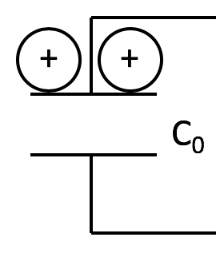
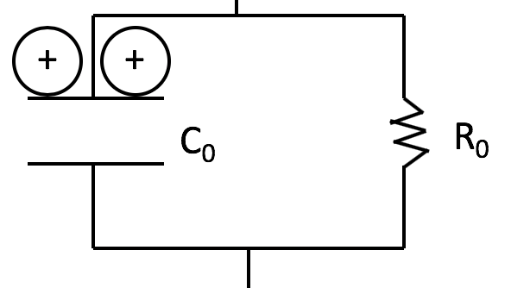
Summary
double the capacitance
τ = R C
→ doubles
double the resistance
Cell higher capacity to hold charge
Cell same capacity to hold charge
V* = I R
→ doubles
Cell higher target voltage
need enough charge here,
to make V big enough ...
... to force future charges
out through the (smaller) channel
So takes longer to charge it up.
doubles
V* fixed
doubles
V* doubles

